Slide 1
New Research & High-Rate Sampling
Austin Sternberg
SCI Lab

Slide 2
New Research: Conversation Detection
Smartwatch Conversation Detection (Liang et al., 2023)
What: Detects the wearer's face-to-face conversations from a commodity smartwatch microphone, with no acoustic model trained on the wearer or people nearby
Found: 83.2% F1 with 39 people in 18 homes and 83.3% in free living; also ran in real time on a watch
Why it matters: Conversation detection without custom hardware
Limitation: Uses microphone audio, so privacy handling matters more than for motion-only methods
Downsampled Audio VAD (Ovaska et al., 2021)
What: Badges downsample audio so speech can't be understood; this team built a deep-learning voice activity detector for that audio
Found: Excellent validation scores, but only moderate accuracy in a real low-noise meeting and across noise levels
Why it matters: Closest to our sound-level approach; lab scores can overstate real-room performance
Limitation: Experiment report; the lessons learned are the main contribution
SCI Lab

Slide 3
New Research: Groups & Stress
F-formations & Roles (Rosatelli et al., 2019)
What: Decides whether two people are in the same conversing group, and who is speaker or listener, from one wearable each (binary proximity + acceleration) using LSTMs
Found: Fusing both signals beat either alone: 0.975 AUC on 30 s windows (MatchNMingle dataset). Each role pair needed a different window length
Why it matters: Group structure with no audio at all; window length is a feature design choice for us
Limitation: Everyone in the group has to wear a sensor
Stressful Conversation Detection (Bari et al., 2020)
What: When a wearable detects stress, was a conversation the cause? Lab and field studies with couples, using ECG/EDA and wrist motion
Found: Stress cycles and hand gestures look different in stressful conversations; 0.83 F1 from one cycle across 38 people, fast enough to respond within 3.9 min
Why it matters: Links conversation to a physiological response
Limitation: Detects stressful conversations, not conversation in general; needs physiological sensors
SCI Lab

Slide 4
New Research: Engagement & Affect
Engagement in Learning (Bustos-López et al., 2022)
What: Review of wearables that detect student engagement from physiological signals
Found: Common signals are HR, skin temp, respiration, SpO2, BP, and ECG; stress and surprise flagged as key features
Why it matters: Closest education-side parallel to meeting engagement
Limitation: Signals are the most commonly used, not proven most reliable
Affect Estimation (Yan et al., 2020)
What: Estimates daily self-reported affect from sensor data, testing ways to handle individual differences
Found: Hard to do well: behavior is complex and people report their own effect differently
Why it matters: A caution for any engagement labels built from self-reports
Limitation: Daily mood, not moment-to-moment states in a meeting
Physiological Synchrony (Holder et al., 2024)
What: Synchronized wearables on people and therapy dogs, recording physiology and behavior through each session
Found: Introduces a subsession heatmap, synchrony table, and metric correlation matrix
Why it matters: Worked example of measuring synchrony between two wearers; the visuals could apply to multiple badges
Limitation: Exploratory pilot in animal therapy, not meetings
SCI Lab

Slide 5
New Research: Workplace & Meetings
Sociometric Workplace Devices (Ito-Masui et al., 2021)
What: Review of badge-style wearables in offices and hospitals
Found: Badge-captured interaction has been linked to teamwork and productivity in offices; validation studies found weaknesses in acute medical settings
Why it matters: Compact overview of where badges work and where they fall short
Limitation: Review only, no new experiment
Collective Intelligence (Pulcinelli et al., 2023)
What: Review of wearables for studying clinical team behavior, which has mostly relied on surveys
Found: Lists what to measure (face-to-face time, proximity, speaking time) and which devices (IR, RFID, Bluetooth) do it, with pros and cons
Why it matters: A catalog for deciding what else the badge should measure
Limitation: Overview; no specific sensor fusion result
Mixed-Reality Meetings (Krug et al., 2025)
What: Five-page CHI workshop paper on large mixed-reality meetings
Found: Proposes adapting what each person sees and hears to reduce overload and fatigue
Why it matters: Frames overload in large hybrid meetings as a design problem
Limitation: Discussion paper, no tested system
SCI Lab

Slide 6
New Research: Fusion & Social Sensing
Multimodal Sensor Fusion (Bello, 2024)
What: Two-page PhD abstract summarizing doctoral work on wearable sensor fusion
Found: Inertial, pressure, and textile capacitive sensing for gestures, head and face patterns, and posture
Why it matters: Supports fusing several cheap sensors, like the Rev2 board's
Limitation: Accuracy numbers are in the thesis, not the abstract
Social Intelligence in AI (Mathur et al., 2024)
What: CMU position paper on AI agents that sense and respond to people
Found: Four challenge areas: ambiguous social constructs, subtle signals, multiple perspectives, and agency
Why it matters: Explains why sensing several people over time is hard
Limitation: No sensor results
Multimodal Interaction Survey (Dritsas et al., 2025)
What: Survey of systems combining speech, gesture, touch, and gaze
Found: Covers fusion design, including time synchronization and decision-level integration
Why it matters: Vocabulary for our own fusion choices
Limitation: Focuses on human-computer interfaces, not group sensing
SCI Lab

Slide 7
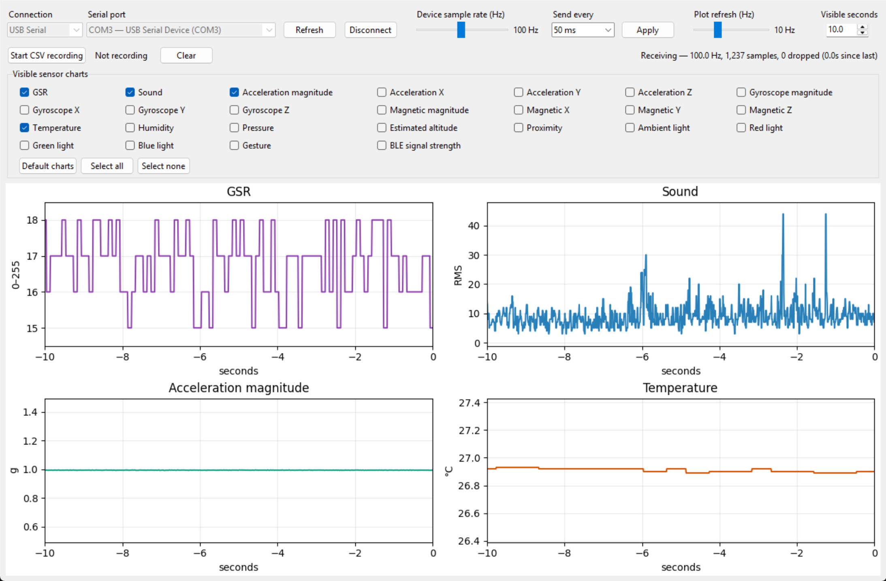
High-Rate Sampling
Sample rate now 1-200 Hz (was 16 Hz)
  High-priority thread on a microsecond timer
  Accel + gyro in one I²C read (4.8 ms → 1.2 ms)
Sampling and sending are independent
  128 KB buffer of compact binary samples
  ~20 bytes per sample instead of ~115 as text
Every sample has a sequence number
  Viewer shows measured rate and dropped samples
SCI Lab

Slide 8
Sending & Buffering
Send interval:
Immediately, or any interval up to 10 min
BLE packs up to 13 samples per notification
USB expands packets into CSV rows
Tested over BLE on Windows:
100 Hz: immediately, 15 s, 30 s, 1 min
200 Hz: every 30 s
No missing samples
Buffer holds about:
200 Hz: 33 s
100 Hz: 63 s
50 Hz: 1.8 min
10 Hz: 4 min
1 Hz: 10+ min
Interval longer than the buffer:
Badge warns and sends early when nearly full
SCI Lab

Slide 9
Live Demo
Connect over Bluetooth LE to HM Badge No.01
Set 100 Hz and a send interval, then Apply
Watch the measured rate and dropped count
Record a CSV
SCI Lab

Slide 10
Work Cited
Liang et al., 2023: https://doi.org/10.1145/3610882
Bari et al., 2020: https://doi.org/10.1145/3432210
Rosatelli et al., 2019: https://doi.org/10.1109/aciiw.2019.8925179
Ovaska et al., 2021: https://doi.org/10.48550/arxiv.2108.05553
Ito-Masui et al., 2021: https://doi.org/10.2144/btn-2020-0160
Pulcinelli et al., 2023: https://doi.org/10.3390/s23249777
Yan et al., 2020: https://doi.org/10.1007/s41666-019-00066-z
Holder et al., 2024: https://doi.org/10.3390/ani14243628
Krug et al., 2025: https://doi.org/10.48550/arxiv.2504.03455
Bello, 2024: https://doi.org/10.1109/percomworkshops59983.2024.10502797
Mathur et al., 2024: https://doi.org/10.48550/arxiv.2404.11023
Dritsas et al., 2025: https://doi.org/10.3390/mti9010006
Bustos-López et al., 2022: https://doi.org/10.3390/bios12070509
SCI Lab

